Slide 1
QlikSense Training
I&D India – QlikSense CoE

Slide 2
Session 04

Slide 3
Session Agenda
Understanding QVD’s
What is QVD file?
Advantages of using QVDs
How to create a QVD
How to load data from QVDs
Incremental loads
Types of Incremental loads
How to do incremental loads

Slide 4
Understanding QVD file
What is a QVD file: (Extension : .qvd)
QVD is a QlikView format and can only be written to and read by QlikView. A single QVD file can store a single table and is created in the load script in a QVW file.
Advantages of using QVDs:
QVD files offer many advantages to your QlikView applications, including the following:
Faster load time: Reading data from QVD is 10-100 times faster than other sources i.e. decreasing load time. It is because QVD creation uses the same algorithms as QlikView uses to store data in memory, the result of that Loading from QVD is faster, when compared to other formats.
Less load on databases and networks: Once data is exported in QVDs, you don’t need to connect with external database again. It reduces the workload on external databases and network. Furthermore, when several QlikView scripts share the same data, it is only necessary to load it once from the source database. The other applications can also make use of the same data via a QVD file.
Incremental loads of QVDs: Incremental load (loading only new/ modified detail of a database) can be done only by using QVDs. It reduces the load time significantly as compared to complete load.
Consolidating data from multiple data sources and databases: Multi-layer QVDs are used to create a with robust model, when data is fetched from multiple data sources.

Slide 5
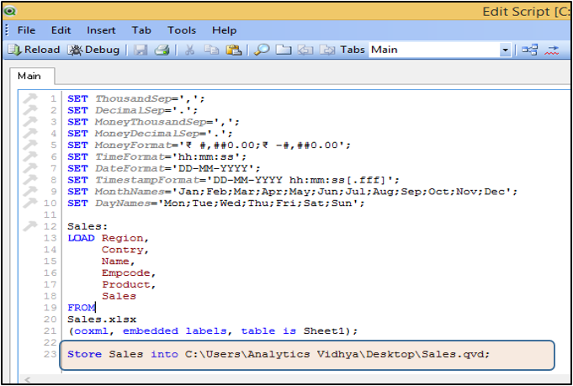
Understanding QVD file
How to create a QVD?
QVDs are most commonly created during the execution of QlikView load script using the STORE command:
Syntax: STORE <TableName> INTO <Path\FileName.qvd>
It is a good practice to have separate application to create QVD files. This layer is used to handle all interaction with source databases. And the result of this interaction can be reloaded quickly from QVD files.

Slide 6
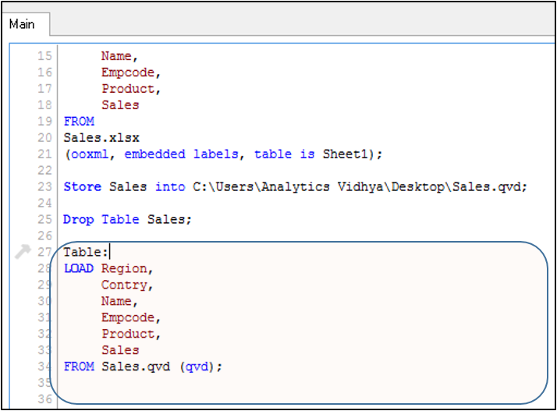
Understanding QVD file
How to load data from QVD?
To read data from QVD, we need to write a LOAD statement (similar to the command to load CSV or excel file).
Syntax:
TableName:
LOAD
FieldList
FROM
<Path\FileName.qvd (qvd) >;
→Managing QVDs is one of most important part in any QlikView application project. It can be used to provide a logical data layer and hence it can act as a data warehouse in absence of one (one of the big benefits of Qlikview in comparison to other BI tools in the market).
→Creating QVDs helps to decrease the database and network load. Once a base QVD is generated, an incremental load script can be run to load only the new or modified records to the QVD. Incremental load also removes the deleted records. As a result of this, your application consumes less space and requires less load time

Slide 7
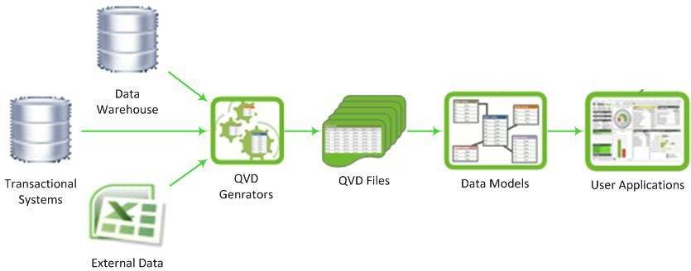
Incremental Loads
What is Incremental Loads?
Incremental load is defined as the activity of loading only new or updated records from the database into an established QVD. Incremental loads are useful because they run very efficiently when compared to full loads, particularly so for large data sets.

Slide 8
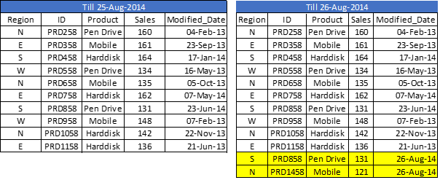
Incremental Loads
Ways to implement Incremental Loads?
1. Insert Only (Do not validate for duplicated records)
2. Insert and Update
3. Insert, Update and Delete
Let us understand each of these 3 scenarios with an example
1. Insert Only:
Let us say, we have sales raw data (in Excel) and whenever a new sales get registered, it is updated with basic details about the sale by modified date. Since, we are working on QVDs, we already have QVD created till yesterday (25-Aug-14 in this case). Now, I want to load only the incremental records
(Highlighted in yellow below).

Slide 9
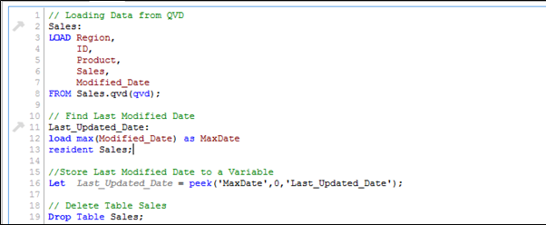
Incremental Loads
To perform this exercise, first create a QVD for data till 25-Aug-14. To identify new incremental records, we need to know the date till which, QVD is already updated. This can be identified by checking the maximum of Modified_date in available QVD file.
In order to identify the last modified date of “Sales. qvd”, following code can help:
Here, I have loaded the last updated QVD into the memory and then identifed the last modified date by storing maximum of “Modified_Date”. Next we store this date in a variable “Last_Updated_Date” and drop the table “Sales”. In above code, I have used Peek() function to store maximum of modified date. Here is it’s syntax:
Peek( FieldName, Row Number, TableName)

Slide 10
Incremental Loads
To perform this exercise, first create a QVD for data till 25-Aug-14. To identify new incremental records, we need to know the date till which, QVD is already updated. This can be identified by checking the maximum of Modified_date in available QVD file.
In order to identify the last modified date of “Sales. qvd”, following code can help:
Here, I have loaded the last updated QVD into the memory and then identifed the last modified date by storing maximum of “Modified_Date”. Next we store this date in a variable “Last_Updated_Date” and drop the table “Sales”. In above code, I have used Peek() function to store maximum of modified date. Here is it’s syntax:
Peek( FieldName, Row Number, TableName)

Slide 11
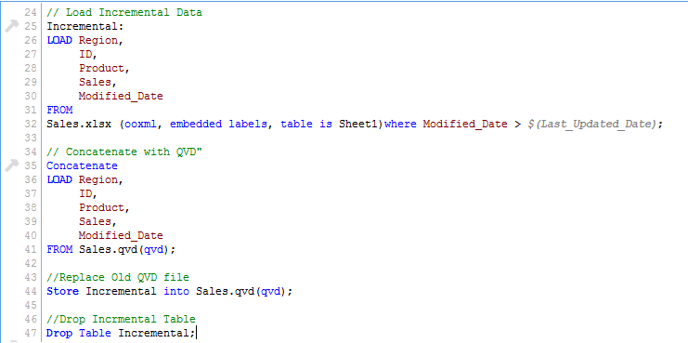
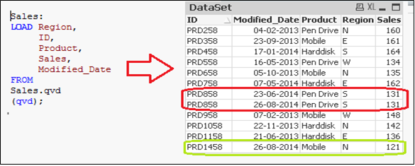
Incremental Loads
This function returns the contents of given field for a specified row from the internal table. FieldName and TableName must be given as a string and Row must be an integer. 0 denotes the first record, 1 the second and so on. Negative numbers indicate order from the end of the table. -1 denotes the last record.
Since we know the date after which the records will be considered as new records, we can Load incremental records of the data set (Where clause in Load statement) and merge them with available QVD (Look at the snapshot below).
In this method we can not update value of existing records.

Slide 12

Incremental Loads
2. Insert and Update method:
As seen in previous example, we are not able to perform check for duplicate records and update existing record. This is where, Insert and Update method comes to help:
In the data set above (Right table), we have one record (ID = PRD1458) to add and another one (ID = PRD858) to update (value of sales from 131 to 140). Now, to update and check for duplicate records, we need a primary key in our data set.
Let’s assume that ID is the primary key and based on modification date and ID, we should be able to identify & classify the new or modified records.

Slide 13
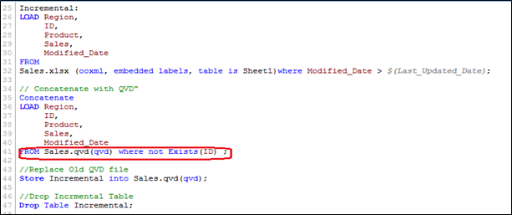
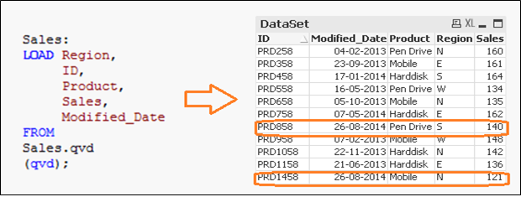
Incremental Loads
In order to execute this method, follow similar steps to identify the new records as we have done in INSERT only method and while concatenating incremental data with existing one, we apply the check for duplicated records or update the value of existing records.
Here, we have loaded only those records where Primary Key(ID) is new and use of Exists() function stops the QVD from loading the outdated records since the UPDATED version is currently in memory so values of existing records gets updated automatically.
Now, we have all unique records available in QVD with an updated sales value for ID(PRD858).

Slide 14
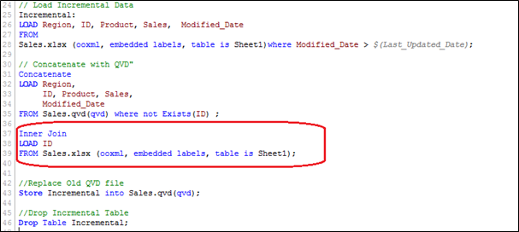
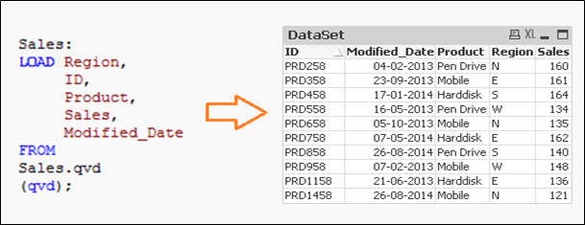
Incremental Loads
3. Insert, Update and Delete method :
The Script for this method is very similar to the INSERT & UPDATE, however here we have an additional step needed to remove deleted records.
We will load primary keys of all records from current data set and apply an inner join with concatenated data set (Old+Incremental). Inner join will retain only common records and therefore delete unwanted records. Let’s assume that we want to delete a record of (ID PRD1058) in the previous example. Here, we have a data set with the addition of one record (ID PRD1458), modification of one record (ID PRD858) and deletion of one record (ID PRD1058).

Slide 15
QlikView Training – Session 04
Thank You

